Slide 1
Proficient Auto Logistics
Q4 2024
Investor Presentation

Slide 2






Who We Are – Proficient Auto Logistics (“PAL”)
PAL is an industry leading specialized freight company focused on providing auto transportation and logistics services utilizing one of the largest auto transportation fleets in North America
The Company is primarily focused on transporting and delivering finished vehicles from auto production plants, ports of entry and rail hubs to a national network of automotive dealerships
Top 3
Largest Auto
Hauler⁽¹⁾
~710
Dedicated
Employees⁽²⁾
~2.2 M
Units
Shipped
50+
Strategically
Located Facilities
1,050+
Auto Transport
Vehicles and Trailers at our Disposal on a Daily Basis
17 of 18
Global Original Equipment Manufacturing Companies (“OEMs”) Served
PAL’s Founding Companies
2

Slide 3
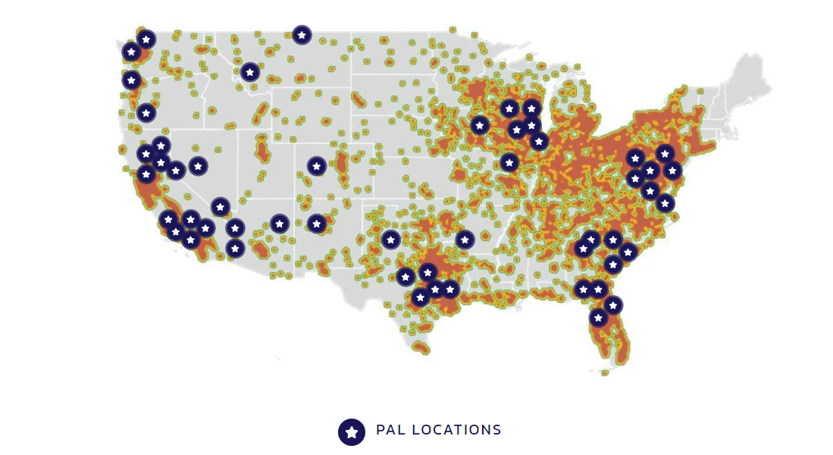
PAL at a Glance
Expansive Geographic Footprint
Strategically located facility network with close proximity to major ports and rail hubs
Proven organic growth strategy with ample opportunity ahead
Multiple touchpoints and strong relationships with leading OEMs
Less Delivery Density
More Delivery Density
Source: Certain information is based on management estimates, which have been derived from third-party sources and internal research, and are based on certain assumptions that management believes to be reasonable.
3

Slide 4

Auto Transport Group (ATG) – Acquired in August
ATG Adds Meaningful Revenue, Profitable Operations and Strong Management Team
Robust Fleet Capacity
Renton, Tacoma & Spokane
Laurel
Headquarters
Ogden, Utah¹
Key Statistics
Portland
Founded in 2001, Auto Transport Group (ATG or “The Company”) is a leading provider of vehicle transportation and shipping services in the U.S.
Headquartered in Ogden (UT), ATG provides its services by utilizing a fleet of 113 tractors and trailers (both company owned and owner-operator)
The fleet is well-equipped with advanced technologies, including dash cameras, GPS, EPOD, telematics, etc., that enables it to provide a high-quality handling and damage free delivery of vehicles
  It also utilizes other technologies including TMS systems, ELD device & systems, fleet maintenance systems, etc.
The Company serves a wide range of customers including vehicle manufacturers, rental fleet owners, auto auctions and dealerships
The Company is certified by various authorities including C-TPAT, CSA, F.A.S.T., SmartWay and other authorities
Las Vegas
Wilmington & National City
Phoenix & El Mirage
- Headquarters
- Ramp/Port Operations
- Other Areas Serviced
Ramp/port operations are also in Salt Lake City, UT.
4

Slide 5
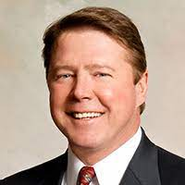
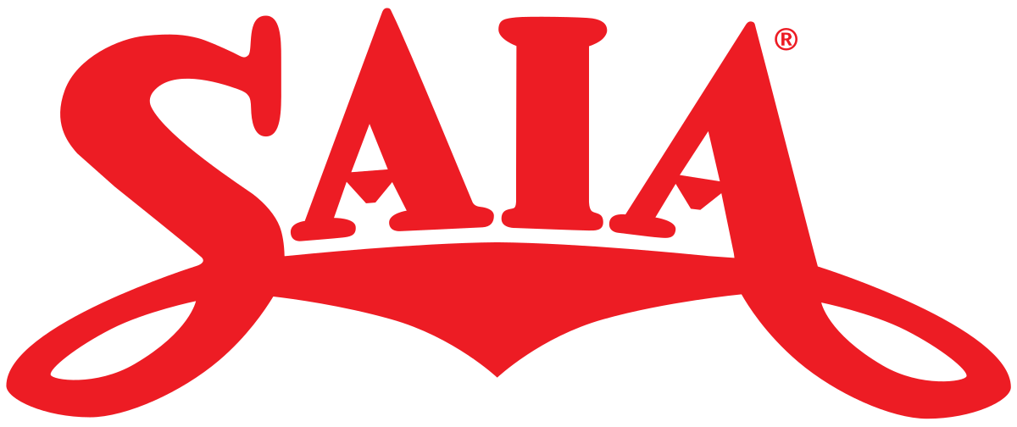
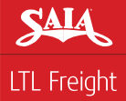













Management Team
Management Team with Proven Success in Creating Shareholder Value
C-Suite Executives
25+ years of experience in the transportation and logistics industry
SAIA’s Share Price⁽¹⁾ Under Rick’s Leadership:
~$7→ ~$428
Richard “Rick” O’Dell
(Current) Non-Executive Chairman of the Board of Directors
(Former) Chief Financial Officer, President and Chief Executive Officer
Chief Executive Officer
10+ years of experience in transportation and logistics industry
(Current) Independent Director
(Former) CEO
(Former) Vice President roles in Operations, Finance, Strategy.
Amy Rice
President & Chief Operating Officer
30+ years of experience in the financial services industry
Assisted in the Sale of FBR & Co. for 1.5x Book Value⁽¹⁾ while Increasing Shareholder Value
PMC Consolidated Holdings, LLC
(Former) Chief Financial Officer
(Former) Executive Vice President, Chief Financial Officer and Chief Administrative Officer
Brad Wright
Chief Financial Officer
Outside Directors
Jim Gattoni
Doug Col
Charles Alutto
John Schraudenbach
(Former) President & Chief
Executive Officer
(Current) EVP & Chief
Financial Officer
(Current) Operating Executive
(Current) Chairman
(Former) Senior Audit Manager
(Former) Director
(Former) President & Chief Executive Officer
(Former) Partner
Data is publicly available.
5

Slide 6





What We Do
Illustrative Move
New + Remarketed Autos Market⁽¹⁾:
~$11,000M
Manufacturing Sites
New Autos Market⁽¹⁾:
~$4,000M
PAL 2023A Revenue⁽²⁾: $415M
Rail Head
Marine Port
Storage Yard
Ancillary Services
PAL will further entrench existing customer relationships through expansion of its storage & logistics services with key OEMs
Dealership

Slide 7
Growing Revenues Despite Declining Production Volumes
Auto Sales (SAAR) vs Revenue vs Delivered Units
Auto Sales
(Units-M)
PAL Revenue
($M)
PAL Delivered Units (Units-M)
Auto Sales (SAAR)
SAAR (Units-M) | 17.2 | 15.5
PAL Units (Units-M) | 1.6 | 2.0
PAL Revenue ($M) | $184 | $415
PAL Revenue/Car Delivered⁽¹⁾ ($) | $105 | $196
2017
2023
Industry sales volumes continue to rebound, and are expected to be a continuing tailwind for the auto transportation and logistics industry throughout the next three to five years
Despite auto sales declining due to the COVID-19 Pandemic, the Company was able to increase sales in a challenging environment

Slide 8












Blue Chip, Leading OEM Customer Base Across North America
Select Global OEM’s PAL Services
Tenure:
31
27
26
24
18
18
Tenure:
15
14
12
10
6
5
$415M of revenue in 2023
Awarded 112 individual contracts⁽¹⁾
No one contract greater than 4% of revenue

Slide 9
Competitive Landscape
PAL vs. Other Major Auto Hauling Carriers
Number of Trucks
OEM Customers | 17 | 8 | 20 | 12 | 9 | 9 | 7 | 6 | 9
Segment
New | ✓ | ✓ | ✓ | ✓ | ✓ | ✓ | ✓ | ✓ | ✓
Remarketed | ✓ | ✓ | ✓ |  |  | ✓
National Network | ✓ |  | ✓ |  |  |  | ✓
Independent Contractor Service | ✓ |  | ✓ | ✓ |  | ✓ | ✓ | ✓ | ✓
Union wages are predominately based on hours as opposed to productivity, encouraging more motivated drivers to chase non-union opportunities where they have greater earnings potential
Union pensions and healthcare obligations result in higher costs compared to non-union carriers

Slide 10
Combined Condensed Unaudited Financial Information
Our management team reviews Adjusted Operating Income and the related Adjusted Operating Ratio, both of which are non-GAAP financial measures, as a basis for comparing the results of financial reporting periods excluding the impact of non-cash expenses related solely to our recent IPO and the concurrent corporate combinations. These measures provide management with the requisite insight regarding progress on operating and integration initiatives. See the Appendix for a reconciliation to the most comparable GAAP measure.
Our management team reviews Adjusted EBITDA and Adjusted EBITDA Margin, both of which are non-GAAP financial measures, to measure the operating performance and financial condition of our business and to make strategic decisions. See the Appendix for additional information regarding the use of Adjusted EBITDA and a reconciliation to the most comparable GAAP measure and Adjusted EBITDA Margin flows from that.

Slide 11
Key Operational & Financial Initiatives
1
Achieve Substantial Cost Synergies through National Procurement Effort
2
Greater efficiency in sharing loads expected to increase truck utilization and equipment capacity for new lanes
3
Adding used car freight to the Company's network and shifting the sales team's strategy to a national approach expected to result in additional backhaul opportunities
4
Shifting to more company trucks/drivers expected to yield incremental margin
5
Implementation of activity-based costing analytics targets profitability by specific lane

Slide 12

PAL’s Dedicated ProFleet Program
Non-Traditional Service-Based Business Model Dedicated to Meet Customer’s Immediate Needs
ProFleet is a differentiated service model that provides ad hoc, dedicated services for a premier blue chip customer
  PAL’s ProFleet is allocated to areas of the country that experience surges in volume, any backlog challenges and is continuously redeployed to challenged areas that require assistance
PAL bills its customer on an hourly basis when its fleet is in use, leading to higher revenue per unit compared to its traditional contractual work
As a result of lower volumes across the industry, PAL has seen softer demand for its ProFleet service
  Q4 2024 volumes are ~70% lower vs. Q4 2023 volumes due to lower volumes with OEM customer and fewer ad hoc needs
ProFleet – Q4 Volume (Thousands)
Q4 YoY % Change: (70%)
2023
2024
Q4 YoY Change: (16.1)
UPDATED TO Q4
ProFleet – Q4 Revenue ($ in millions)
Q4 YoY % Change: (74%)
2023
2024
Q4 YoY $ Change: ($10.5)
ProFleet – Q4 Revenue per Unit ($ in actual)
40,000+
Units Delivered
Year-to-Date⁽¹⁾
Q4 YoY % Change: (13%)
2023
2024
32 - 37
Dedicated
Tractors-Trailers Units
CY 2025
Customer Contract End Date For ProFleet Offering
Q4 YoY $ Change: ($82.2)
Revenue per Unit in actual $ amount displayed.
12

Slide 13
Challenging Environment Reduces Spot Buys Revenue
Revenue Breakdown
Revenue Breakdown: Q4 2023
Revenue Breakdown: Q4 2024
UPDATED TO Q4
PAL participates in the spot market as profitable opportunities arise, which has historically yielded higher revenue per unit compared to its contractual OEM business
In Q4 2024, PAL was presented with far fewer spot buy opportunities which had a meaningful impact on total revenue and fixed cost coverage.
  Given the softer than expected SAAR figures and depressed consumption for new automobiles, PAL’s spot buys revenue as a percentage of total revenue has decreased ~68% year-over-year for Q4 ’23 vs. Q4’ 24
However, given the Company’s service offering and overall revenue mix, the Company’s contractual revenue continues to provide a reliable portion of total revenue
13

Slide 14
PAL’s ProFleet – Breakdown
Volume and Revenue Breakdown: ProFleet
ProFleet – Volume (Thousands)
YoY % Change:
(43%)
(29%)
(49%)
(70%)
2024
YoY Change:
(7.2)
(5.1)
(10.3)
(16.0)
2023
UPDATED TO Q4
ProFleet – Revenue ($ in millions)
YoY % Change:
(57%)
(51%)
(71%)
(70%)
2024
YoY $ Change:
($8.3)
($7.6)
($11.5)
($10.5)
2023
ProFleet – Revenue per Unit ($ in actual)
YoY % Change:
(24%)
(32%)
(44%)
(13%)
2024
YoY $ Change:
($207.4)
($264.5)
($338.9)
($82.2)
2023
14

Slide 15
PAL’s Spot Buys – Breakdown
Volume and Revenue Breakdown: Spot Buys
Spot Buys – Volume (Thousands)
YoY % Change:
(4%)
29%
(29%)
(27%)
2024
YoY Change:
(1.3)
7.7
(8.6)
(8.9)
2023
UPDATED TO Q4
Spot Buys – Revenue ($ in millions)
YoY % Change:
58%
39%
(58%)
(68%)
2024
YoY $ Change:
$5.1
$3.5
($5.6)
($10.4)
2023
Spot Buys – Revenue per Unit ($ in actual)
YoY % Change:
65%
8%
(40%)
(57%)
2024
YoY $ Change:
$184.3
$27.0
($133.6)
($258.0)
2023
15

Slide 16
Expansive Capacity Network with Asset-Based Reliability and Asset-Light Flexibility
Robust Fleet Capacity
A Leading Company-Owned Fleet⁽¹⁾
Revenue Breakdown
By Driver Type
2023A Combined Transportation Revenue
Tractor-Trailer Units
Count
Average Age
800 Units
5.6 Years
Over time, the Company expects to invest in its fleet and convert more freight to Company hauls, as Management believes company trucks generate ~4% greater operating margins
Given the shorter nature of its hauls, PAL is able to extend the useful life of its assets compared to over-the-road longhaul carriers

Slide 17





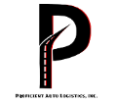






Historical Success in the LTL Industry Mirrors Present Opportunity in Auto Transportation and Logistics
Market Share Shifting from Union to Non-Union Auto Transportation & Logistics Companies
Organic Growth (Regionally)
Less Empty Miles
+
+
Sustainable Organic Revenue Growth
Proficient Auto Logistics
Focus on Service
Scale & Regional Density
Pricing Discipline
+
+
Regional Non-Union LTLs
Dramatically Improved Operating Margins
Regional Acquisitions of a Highly Fragmented Market
Focus on Damage Management
LTL Industry over the Last 40 Years
Non-union regional LTLs have grown at the expense of unionized carriers over the last 20+ years due to deregulation
Revenue growth well in excess of industrial production
Saia over the Last 15 Years⁽¹⁾
Revenue has grown at a 9.2% CAGR from $0.85B to $2.90B
Operating Margin has grown from (0.4%) to 16.0%
Stock Price has grown at a 34.1% CAGR from $7 to $428
Proficient Auto Logistics
2023 Combined Revenue of $415M
2023 Combined Operating Margin of 6.7%
Management is prioritizing sustainable organic growth and margin enhancement

Slide 18
Conclusion – A Clear Path to Creating Shareholder Value
✓
Strong Management and Leadership Team with Track Record of Creating Shareholder Value
✓
Compelling Industry Tailwinds Underpinning Future Growth
✓
Strategically Positioned Platform in Large Addressable Market with High Barriers to Entry
✓
Entrenched Relationships and Long-Term Dedicated Contracts with Leading, Blue Chip Customer Base
✓
Significant Financial Momentum, with a Revenue CAGR of 15% from 2017 to 2023
✓
Tangible M&A Opportunities in a Highly Fragmented Industry to Accelerate Organic Growth

Slide 19
A
Appendix

Slide 20
Executing on Backhaul Synergies
Case Study: Deluxe/Sierra Mountain Network Collaboration
Sierra
Mountain
Deluxe
Sierra
Mountain
Sierra
Mountain
Sierra
Mountain
Deluxe
Represents significant backhaul opportunities
States with a diagonal pattern represent overlapping territories
Terminal
Loaded Mile
Empty Mile
Regions Covered⁽¹⁾
Increased Utilization = Incremental EBITDA for PAL
Delta
Sierra
Deluxe
Tribeca
ATG
Note: Proficient Auto Transport serves all 48 contiguous states

Slide 21
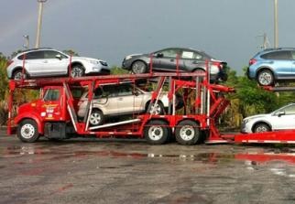
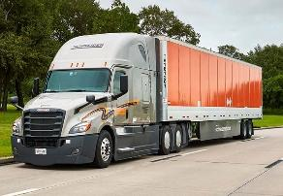
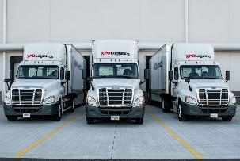
Significant Barriers to Entry vs Van Truckload
Auto Transportation
Van Truckload
Less Than Truckload
Highly Specialized Auto Rig
Standard Truckload Hauler
LTL Hauler and Terminal
~$400k
Cost of an
auto rig⁽¹⁾
~70
# of auto
haulers⁽¹⁾⁽²⁾
~$250k
Cost of a
tractor & trailer⁽¹⁾
~750k
# of TL
carriers⁽³⁾
~$250k
Cost of a
tractor & trailer⁽¹⁾
~200
# of LTL
carriers⁽⁵⁾
70%
Market share for top 10 companies⁽¹⁾
<10%
Market share for top 10 companies⁽¹⁾⁽⁴⁾
75%+
Market share for top 10 companies⁽⁶⁾
Typical Service Attributes by Hauling Type⁽¹⁾
Focus on Service
Consolidated Industry
Specialized Equipment
Strategic Real Estate
National Footprint

Slide 22
Favorable Industry Tailwinds Driving Secular Pricing Growth
Indexed Revenue per Unit
The auto transportation & logistics industry has demonstrated significantly more stable pricing power and is not correlated to the broader, more cyclical overall freight market

Slide 23
Historical Financial Summary
Revenue
EBITDA⁽¹⁾⁽²⁾
$ in millions
$ in millions
EBITDA Margin %
~13% CAGR
10.0%
13.4%
11.2%
10.5%
Strong pricing power and increasing operating leverage as the business scales have led to margin expansion
Asset-right business model yields impressive free cash flow to be reinvested in the Company in support of Management's planned shift toward more in-house capacity to boost margins

Slide 24
Non-GAAP Reconciliations
Reconciliation of Non-GAAP Financial Measures

Slide 25
Non-GAAP Reconciliations
Reconciliation of Non-GAAP Financial Measures

